Slide 1
CS 375 Final Project
Roy Conboy

Slide 2
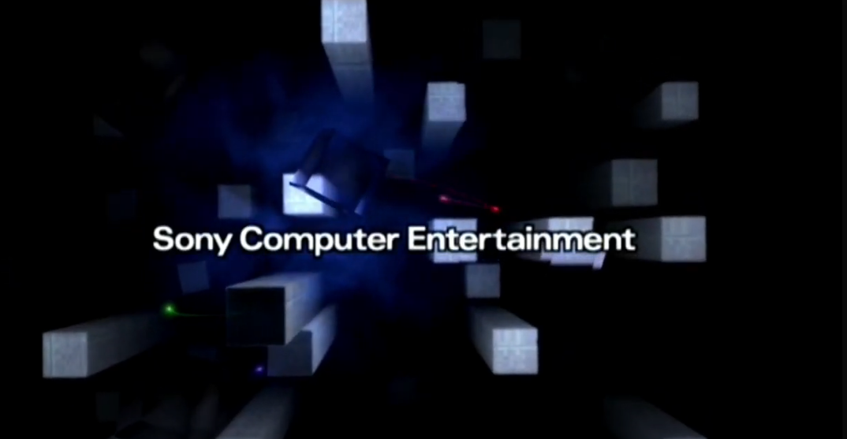
Original Idea

Slide 3
TIMELINE
Week 1
Figure out canvas size, canvas orientation and start modeling objects or figuring out the scope of them.
Week 2
Get objects rendered and situate them inside the canvas as positionally correct I can get them.
Week 3
Figure out the movement, POV, and get started on bringing everything together.
Week 4
Work on presentation, fix bugs and hopefully not scramble my eggs too much.

Slide 4

Final Product

Slide 5
Where I fell Short
NO POSTPROCESSING
OBJECT SIZES AND ALGORITHMS
I didn’t utilize the library “EffectComposer” with three.js
This would have allowed me to give more glow to certain textures and objects.
My “buildings” don’t have a systematic creation algorithm, some have overlap.
With larger sizes in general, there would be more depth.​

Slide 6
Wow / Crap - Moments
SMOKE TEXTURE
& ANIMATION
IMPLEMENTING
POSTPROCESSING
It really brought the scene to life when the smoke was animated and rotating opposite the canvas.
Realized I had underestimated the complexity and rendering pipeline to get postprocessing working without completely redoing the foundation I had already built.​

Slide 7
THANK YOU
Roy Conboy
conboyr@sonoma.edu
https://github.com/conboyr/CS-375/tree/main/Final-Project

